Slide 1


TastyTalks
An Engaging Social Platform for Food Enthusiasts, Chefs & Recipe Communities

Slide 2
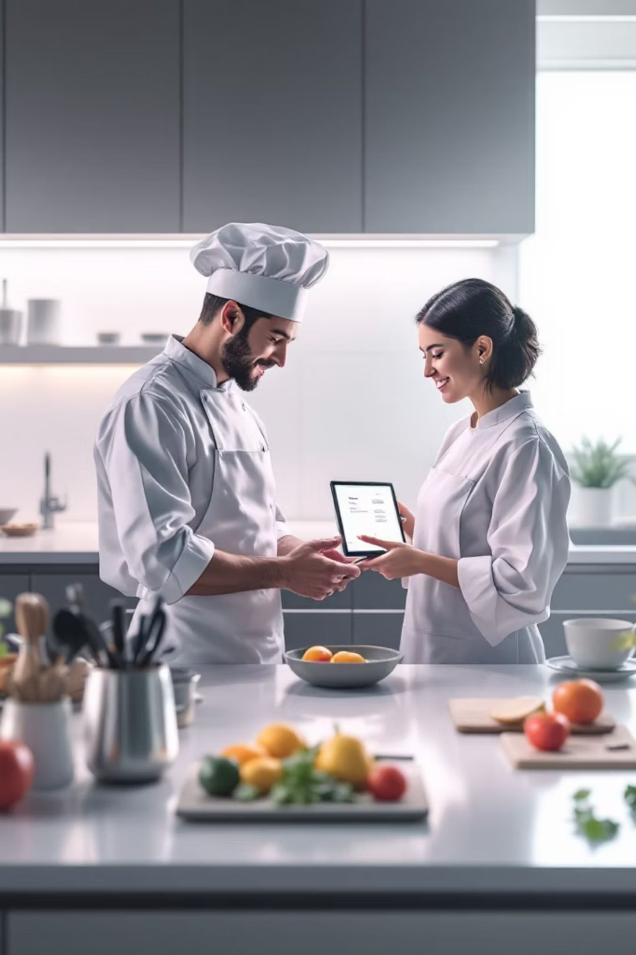

NOVELTY
What Makes TastyTalks Unique?
TastyTalks introduces a structured, role-based social platform purpose-built for the food community — combining interaction, moderation, and engagement in one cohesive system.
Role-Based Interaction
Three distinct roles — Foodie, Chef, and Admin — each with tailored permissions and capabilities, enabling meaningful, context-aware participation.
Moderated Content
Admins oversee posts and recipes to maintain quality standards, ensuring a trustworthy and spam-free environment for all users.
Structured Feedback
Users can rate, review, and comment on recipes with a guided feedback format that promotes constructive, organized dialogue.
Community Engagement
Follow systems, recipe collections, and trending feeds encourage ongoing discovery and foster a vibrant culinary community.

Slide 3
ADAPTABILITY
A Flexible, Future-Ready Architecture
Built to Grow Beyond Food
TastyTalks is designed with extensibility at its core. The platform's architecture does not lock it into a single domain — the same role-based and modular framework can be re-deployed for fitness coaching, travel journaling, or DIY crafts communities.
Role and permission logic is domain-agnostic
Cloud deployment supports horizontal scaling
AI recommendation engine planned for Phase 2
Mobile-first expansion targeted for future releases

Slide 4

EVALUATION
How the System is Evaluated
TastyTalks is assessed across five key dimensions that together reflect both technical robustness and real-world usability.
1
2
3
User Engagement
Content Quality
Moderation Effectiveness
Measured through likes, comments, shares, and session duration — indicating content resonance and community activity levels.
Assessed by structured ratings and peer reviews — ensuring recipes meet community standards for clarity and accuracy.
Tracked via flagged content resolution rates and admin response times — reflecting platform safety and reliability.
4
5
System Performance
User Trust
Evaluated on page load speed, uptime, and API response times under simulated user loads.
Gauged through onboarding surveys and post-session feedback — measuring confidence in platform safety and content integrity.

Slide 5



ACCESSIBILITY
Dissemination & Accessibility
Designed for Everyone
TastyTalks prioritizes ease of use above all. The interface follows intuitive navigation patterns so that both tech-savvy chefs and casual foodies can engage without friction.
Web-Based Access
Cloud Deployment Ready
Fully browser-accessible — no installation required. Works on desktop, tablet, and mobile browsers.
Responsive layout adapts to all screen sizes
Minimal learning curve with guided onboarding
Lightweight front-end ensures fast loading
Compatible with platforms like AWS, Google Cloud, and Azure for scalable, low-latency delivery.
Future Mobile Support
A dedicated mobile application is planned as a next-phase enhancement for on-the-go access.

Slide 6

CONCLUSION
TastyTalks: A Platform That Delivers
Key Takeaways
TastyTalks demonstrates that a well-structured, role-based social platform can meaningfully elevate community interaction around food — with the design principles transferable to many other domains.
🍴 Innovation
📈 Scalability
🌐 Real-World Applicability
Role-based architecture and structured feedback distinguish TastyTalks from generic social platforms.
Modular design and cloud readiness position the system for growth beyond its initial scope.
Deployable today, extensible tomorrow — TastyTalks is production-ready for real community use.

Slide 7
THANK YOU
2410030076 – KODALI NAGA SREEJA
2410030180 – ANUGU SHIVA KUMAR REDDY
2410030228 – BIJJU ADITHI YADAV
2410030229 – LIKITHA THUMMA
2410030232 – H.ESHA MANOGNA

